Slide 1
MediPort: Your Unified Digital Health Identity
A Modern Digital Healthcare Platform
ANEESH VISHWANAATH BHATTU | 2501050055
M.Tech CSE | 25CS5103 - Frontend Development Frameworks
Advisor: Dr. B. Chaithanya Krishna

Slide 2
Abstract
MediPort is a secure, role-based digital healthcare platform designed to centralize patient medical records into a unified digital health identity. The system enables patients, doctors, chemists, and laboratory technicians to access relevant medical information through controlled permissions. Built using modern frontend frameworks, MediPort focuses on usability, data privacy, and real-time access. Key features include comprehensive patient profiles, secure prescription management, emergency QR access, and an AI-powered medication conflict checker. The platform demonstrates how scalable frontend architecture can improve healthcare efficiency and treatment continuity.

Slide 3

Introduction
Healthcare records are often fragmented across hospitals, labs, and pharmacies
Lack of unified access leads to repeated tests and treatment delays
Patients have limited control over their medical data
MediPort addresses this gap using a modern, secure, frontend-driven approach
Focuses on usability, role-based access, and real-time data availability

Slide 4

Existing System & Disadvantages
Existing System
Disadvantages
Isolated hospital-specific record systems
Fragmented medical history
Poor interoperability between institutions
Manual sharing of reports and prescriptions
High chances of medication errors
Limited digital access for patients
No centralized patient control
Limited emergency accessibility

Slide 5







Objectives
Design intuitive, responsive UI across all devices
Implement role-based dashboards for different user types
Secure authentication and authorization with Firebase
Enable real-time data retrieval and updates
Improve UX with modern, reusable components
Incorporate AI-based medication conflict detection
Demonstrate industry-relevant frontend development practices

Slide 6
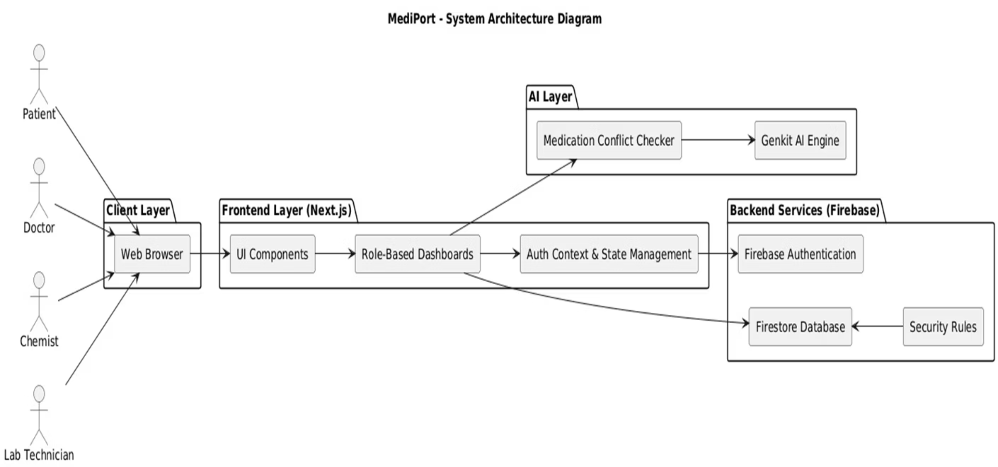
System Architecture

Slide 7




System Architecture
The MediPort system follows a three-tier architecture:
Frontend Layer
Backend Layer
React-based responsive UI with role-based dashboards
Firebase services for authentication and real-time data management
Database Layer
Integration
Firestore for secure, scalable data storage
Seamless API communication between layers with encrypted data transmission

Slide 8




Proposed System: MediPort
Unified digital health identity for each patient
Centralized and secure medical data storage
Role-based access for patients, doctors, chemists, and lab technicians
Real-time data availability across stakeholders
Emergency QR-based access to critical information
AI-powered decision support for medication safety

Slide 9
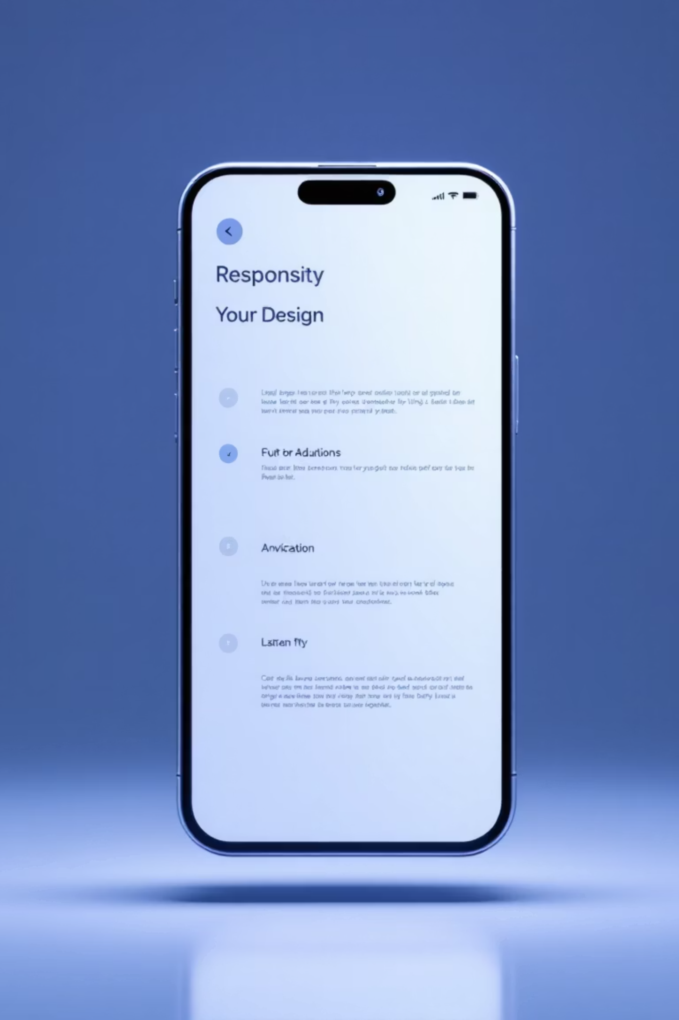
User Interface Design
Clean, modern, and responsive UI design
Role-specific dashboards for different users
Minimal navigation complexity
Built with Tailwind CSS and reusable UI components
Focus on accessibility and usability
Optimized for both desktop and mobile devices
UI screenshots and wireframes showcase the implementation

Slide 10





Database Connectivity
Firebase Firestore
Firebase Firestore used as cloud-based NoSQL database
Real-time Data Sync
Real-time data synchronization across all users
Secure Operations
Secure read/write operations using security rules
Structured Collections
Structured collections for users, patients, prescriptions, and reports
Seamless Integration
Seamless frontend–database integration with encrypted communication

Slide 11





Key Features
Secure user authentication and role-based access control
Personalized dashboards for patients, doctors, chemists, and lab technicians
Comprehensive patient profiles with vitals and medical history
Secure prescription management and medical report uploads
Emergency QR code access to critical patient information
AI-powered medication conflict detection
Real-time data synchronization with cloud database

Slide 12

Technology Stack
Frontend
React, Next.js, TypeScript, Tailwind CSS
UI Components
Shadcn/UI
Authentication
Firebase Authentication
Database
Firestore (Cloud-based)
AI Integration
Google Genkit
Architecture
Component-based, modular design with efficient state management

Slide 13

Results & Achievements
01
All major features successfully implemented and verified
02
Role-based dashboards functioning with proper access control
03
Real-time data updates confirmed across all user types
04
AI medication conflict checker producing accurate, actionable results
05
Emergency QR access feature effectively displaying critical patient information
06
Smooth navigation and fast response times under normal usage
07
Efficient component rendering with optimized state management
08
System meets functional and usability expectations

Slide 14
Conclusion
MediPort successfully demonstrates a modern, secure, and user-centric digital healthcare platform that solves the critical problem of fragmented medical records. By implementing a unified digital health identity with role-based access control, the system enables seamless collaboration between patients, doctors, chemists, and laboratory technicians.
Key Achievements
Responsive and intuitive UI using React, Next.js, and Tailwind CSS
Secure authentication and real-time data synchronization
Scalable cloud-based architecture with Firebase
Improved treatment continuity and reduced medical errors
Production-ready frontend solution for healthcare applications

Slide 15

Future Enhancements
1
Interoperability standards for seamless integration with external hospital systems
2
Telemedicine features including video consultations and appointment scheduling
3
Advanced accessibility features with multilingual support
4
Progressive Web App (PWA) support for offline access
5
Enhanced performance optimizations for low-connectivity environments
6
Integration with national health databases for improved continuity of care
7
Advanced analytics and reporting capabilities for healthcare providers

Slide 16
References
React Documentation – https://react.dev
Next.js Documentation – https://nextjs.org
Firebase Documentation – https://firebase.google.com
Tailwind CSS – https://tailwindcss.com
Google Genkit – https://cloud.google.com/genkit
IEEE Research on Electronic Health Records
World Health Organization - Digital Health Systems

Slide 17
Thank You
We appreciate your time and attention to the MediPort presentation.
ANEESH VISHWANAATH BHATTU
Roll No: 2501050055
Course: M.Tech CSE - Frontend Development Frameworks
Guide: Dr. B. Chaithanya Krishna

